Slide 1
Chapter 19 PHP
簡廷因 Ting-Ying Chien
2024.12.14

Slide 2
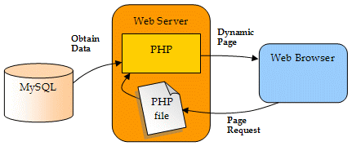
https://static.daniweb.com/attachments/0/phpmysql-ch4-fig1.gif

Slide 3
Web Resources
http://php.net/docs.php
http://www.w3schools.com/php/

Slide 4
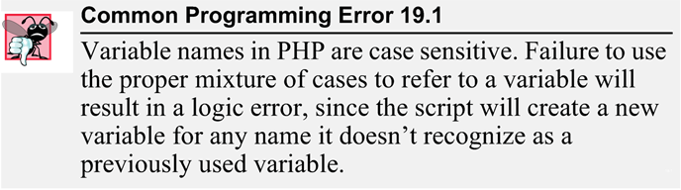

Simple PHP Program

Slide 5

Simple PHP Program
test.php
<!DOCTYPE html>
<html>
<?php
$name = "Paul"; // declaration and initialization
?><!-- end PHP script -->
<head>
<meta charset = "utf-8">
<title>Simple PHP document</title>
</head>
<body>
<h1><?php print( "Welcome to PHP, $name!" ); ?></h1>
</body>
</html>
// php comment
<!-- --> html comment

Slide 6
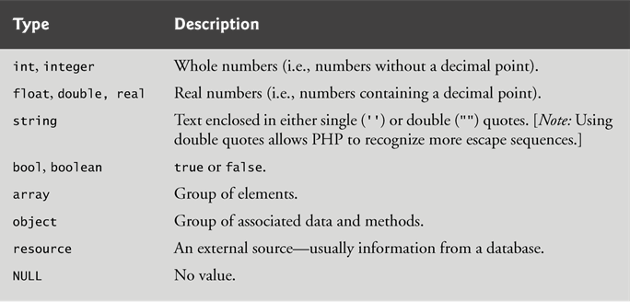
Simple PHP Program
PHP variables are loosely typed - they can contain different types of data.

Slide 7
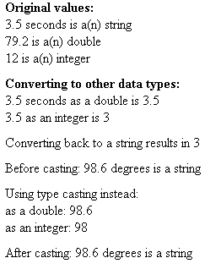
Converting Between Data Types
<!DOCTYPE html>
<html>
<head>
<meta charset = "utf-8">
<title>Data type conversion</title>
<style type = "text/css">
p { margin: 0; }
.head { margin-top: 10px; font-weight: bold; }
.space { margin-top: 10px; }
</style>
</head>
<body>
<?php
$testString = "3.5 seconds";
$testDouble = 79.2;
$testInteger = 12;
?>
<p class = "head">Original values:</p>
<?php
print( "<p>$testString is a(n) " . gettype( $testString ). "</p>" );
print( "<p>$testDouble is a(n) " . gettype( $testDouble ). "</p>" );
print( "<p>$testInteger is a(n) " . gettype( $testInteger ). "</p>" );
?>
<p class = "head">Converting to other data types:</p>
<?php
print( "<p>$testString " );
settype( $testString, "double" );
print( " as a double is $testString</p>" );
print( "<p>$testString " );
settype( $testString, "integer" );
print( " as an integer is $testString</p>" );
settype( $testString, "string" );
print( "<p class = ‘space’>Converting back to a string results in $testString</p>" );
$data = "98.6 degrees";
print( "<p class = 'space'>Before casting: $data is a " . gettype( $data ) . "</p>" );
print( "<p class = 'space'>Using type casting instead:</p>
<p>as a double: " . (double) $data . "</p>" ."<p>as an integer: " . (integer) $data . "</p>" );
print( "<p class = ‘space’>After casting: $data is a " . gettype( $data ) . "</p>" );
?>
</body>
</html>

Slide 8
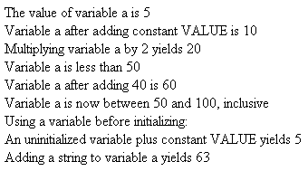
Arithmetic Operators
<!DOCTYPE html>
<html>
<head>
<meta charset = "utf-8">
<style type = "text/css">
p { margin: 0; }
</style>
<title>Using arithmetic operators</title>
</head>
<body>
<?php
$a = 5;
print( "<p>The value of variable a is $a</p>" );
define( "VALUE", 5 );
$a = $a + VALUE;
print( "<p>Variable a after adding constant VALUE is $a</p>" );
$a *= 2;
print( "<p>Multiplying variable a by 2 yields $a</p>" );
if ( $a < 50 )
print( "<p>Variable a is less than 50</p>" );
$a += 40;
print( "<p>Variable a after adding 40 is $a</p>" );
if ( $a < 51 )
print( "<p>Variable a is still 50 or less</p>" );
else if ( $a < 101 )
print( "<p>Variable a is now between 50 and 100, inclusive</p>" );
else
print( "<p>Variable a is now greater than 100</p>" );
print( "<p>Using a variable before initializing: $nothing</p>" );
$test = $num + VALUE;
print( "<p>An uninitialized variable plus constant VALUE yields $test</p>" );
$str = "3 dollars";
$a += $str;
print( "<p>Adding a string to variable a yields $a</p>" );
?>
</body>
</html>
define constant

Slide 9
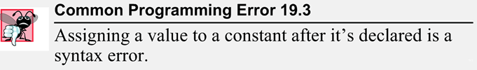
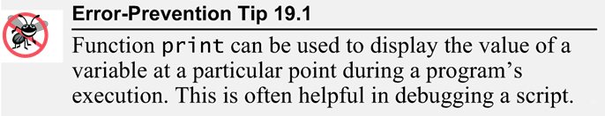
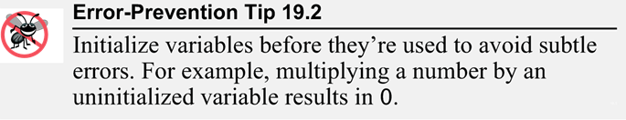
Arithmetic Operators

Slide 10
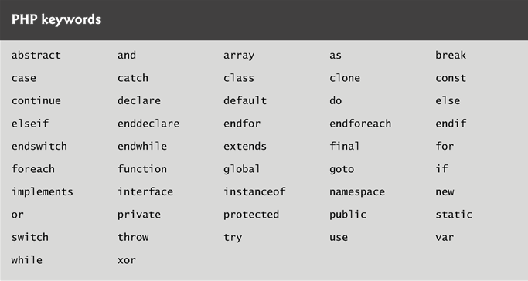
Arithmetic Operators
keywords

Slide 11
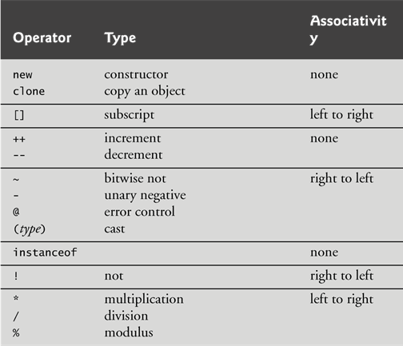
Arithmetic Operators

Slide 12
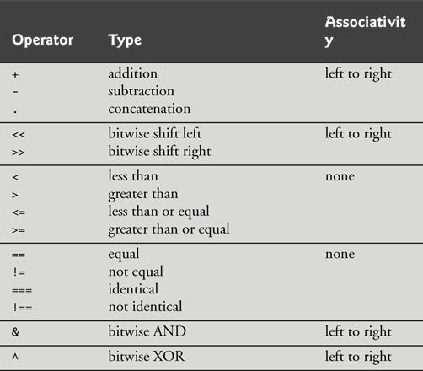
Arithmetic Operators

Slide 13
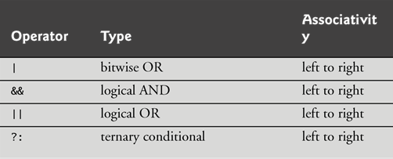
Arithmetic Operators

Slide 14
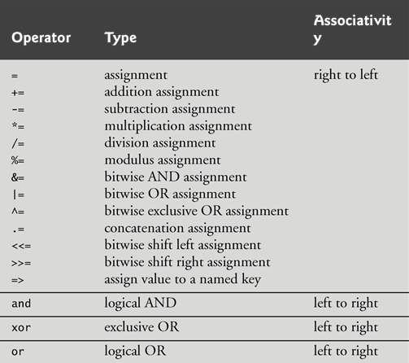
Arithmetic Operators

Slide 15
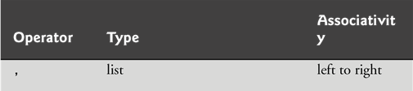
Arithmetic Operators

Slide 16
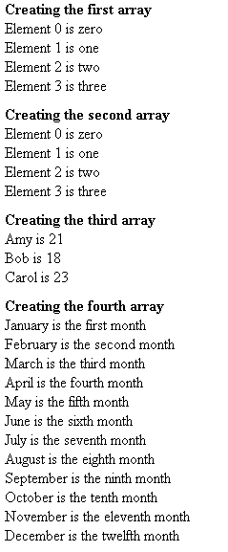
Initializing and Manipulating Arrays
<!DOCTYPE html>
<html>
<head>
<meta charset = "utf-8">
<title>Array manipulation</title>
<style type = "text/css">
p { margin: 0; }
.head { margin-top: 10px; font-weight: bold; }
</style>
</head>
<body>
<?php
print( "<p class = 'head'>Creating the first array</p>" );
$first[ 0 ] = "zero";
$first[ 1 ] = "one";
$first[ 2 ] = "two";
$first[] = "three";
for ( $i = 0; $i < count( $first ); ++$i )
print( "Element $i is $first[$i]</p>" );
print( "<p class = 'head'>Creating the second array</p>" );
$second = array( "zero", "one", "two", "three" );
for ( $i = 0; $i < count( $second ); ++$i )
print( "Element $i is $second[$i]</p>" );
print( "<p class = 'head'>Creating the third array</p>" );
$third[ "Amy" ] = 21;
$third[ "Bob" ] = 18;
$third[ "Carol" ] = 23;
for ( reset( $third ); $element = key( $third ); next( $third ) )
print( "<p>$element is $third[$element]</p>" );
print( "<p class = 'head'>Creating the fourth array</p>" );
$fourth = array(
"January" => "first", "February" => "second", "March" => "third",
"April" => "fourth", "May" => "fifth", "June" => "sixth",
"July" => "seventh", "August" => "eighth", "September" => "ninth",
"October" => "tenth", "November" => "eleventh", "December" => "twelfth" );
foreach ( $fourth as $element => $value )
print( "<p>$element is the $value month</p>" );
?>
</body>
</html>

Slide 17
Initializing and Manipulating Array
Assigning a value to an element where the index is omitted appends a new element to the end of the array.
count function return the total number of elements in the array.
An array with noninterger indices is called an associative array.
reset function sets the internal pointer to the first array element
key function returns the index of the element currently referenced by the internal pointer.
next function moves the internal pointer to the next element and returns the element.

Slide 18

String Comparisons
<!DOCTYPE html>
<html>
<head>
<meta charset = "utf-8">
<title>String Comparison</title>
<style type = "text/css">
p { margin: 0; }
</style>
</head>
<body>
<?php
$fruits = array( "apple", "orange", "banana" );
for ( $i = 0; $i < count( $fruits ); ++$i )
{
if ( strcmp( $fruits[ $i ], "banana" ) < 0 )
print( "<p>" . $fruits[ $i ] . " is less than banana " );
else if ( strcmp( $fruits[ $i ], "banana" ) > 0 )
print( "<p>" . $fruits[ $i ] . " is greater than banana " );
else
print( "<p>" . $fruits[ $i ] . " is equal to banana " );
if ( $fruits[ $i ] < "apple" )
print( "and less than apple!</p>" );
else if ( $fruits[ $i ] > "apple" )
print( "and greater than apple!</p>" );
else if ( $fruits[ $i ] == "apple" )
print( "and equal to apple!</p>" );
}
?>
</body>
</html>

Slide 19
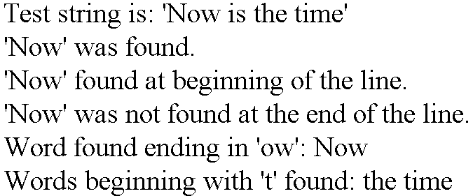
String Processing with Regular Expressions
<!DOCTYPE html>
<html>
<head>
<meta charset = "utf-8">
<title>Regular expressions</title>
<style type = "text/css">
p { margin: 0; }
</style>
</head>
<body>
<?php
$search = "Now is the time";
print( "<p>Test string is: '$search'</p>" );
if ( preg_match( "/Now/", $search ) )
print( "<p>'Now' was found.</p>" );
if ( preg_match( "/^Now/", $search ) )
print( "<p>'Now' found at beginning of the line.</p>" );
if ( !preg_match( "/Now$/", $search ) )
print( "<p>'Now' was not found at the end of the line.</p>" );
if ( preg_match( "/\b([a-zA-Z]*ow)\b/i", $search, $match ) )
print( "<p>Word found ending in 'ow': " . $match[ 1 ] . "</p>" );
print( "<p>Words beginning with 't' found: " );
while ( preg_match( "/\b(t[[:alpha:]]+)\b/i", $search, $match ) )
{
print( $match[ 1 ] . " " );
$search = preg_replace( "/" . $match[ 1 ] . "/", "", $search );
}
print( "</p>" );
?>
</body>
</html>

Slide 20
String Processing with Regular Expressions
preg_match
Perform a regular expression match
int preg_match ( string $pattern , string $subject [, array &$matches])
returns 1 if the pattern matches given subject, 0 if it does not, or FALSE if an error occurred.
preg_replace
Perform a regular expression search and replace
mixed preg_replace ( mixed $pattern , mixed $replacement , mixed $subject)
returns an array if the subject parameter is an array, or a string otherwise.

Slide 21
String Processing with Regular Expressions
$search = "Now is the time";
print( "<p>Test string is: '$search'</p>" );
if ( preg_match( "/Now/", $search ) )
print( "<p>'Now' was found.</p>" );
if ( preg_match( "/^Now/", $search ) )
print( "<p>'Now' found at beginning of the line.</p>" );
if ( !preg_match( "/Now$/", $search ) )
print( "<p>'Now' was not found at the end of the line.</p>" );
^ : match the beginning of a string
$ : match the end of a string

Slide 22
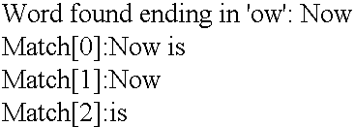
String Processing with Regular Expressions
If matches is provided, then it is filled with the results of search. $matches[0] will contain the text that matched the full pattern, $matches[1] will have the text that matched the first captured parenthesized subpattern, and so on.
/i : case-insensitive pattern match
\b: word boundary
$search = "Now is the time";
print( "<p>Test string is: '$search'</p>" );
if ( preg_match( "/\b([a-zA-Z]*ow)\b/i", $search, $match ) )
print( "<p>Word found ending in 'ow': " . $match[ 1 ] . "</p>" );
if ( preg_match( "/\b([a-zA-Z]*ow)\s([a-zA-Z]*)/i", $search, $match ) )
{
print( "<p>Match[0]: " . $match[ 0 ] . "</p>" );
print( "<p>Match[1]: " . $match[ 1 ] . "</p>" );
print( "<p>Match[2]: " . $match[ 2 ] . "</p>" );
}

Slide 23
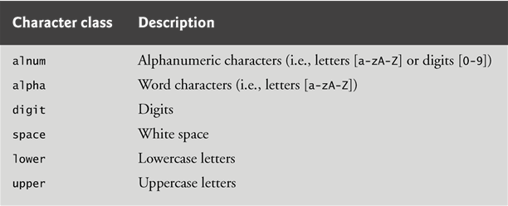
String Processing with Regular Expressions
print( "<p>Words beginning with 't' found: " );
while ( preg_match( "/\b(t[[:alpha:]]+)\b/i", $search, $match ) )
{
print( $match[ 1 ] . " " );
$search = preg_replace( "/" . $match[ 1 ] . "/", "", $search );
}

Slide 24
Exercise
$email = userID@domain
match[1] = userID
match[2] = domain
E.g : tinin@saturn.yzu.edu.tw
match[1] = tinin
match[2] = saturn.yzu.edu.tw
$ip = 140.138.145.75
match[1] = 140.138
match[2] = 145
match[3] = 75

Slide 25
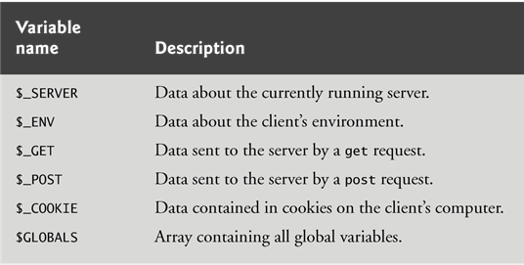
Form Processing and Business Logic
Superglobal arrays

Slide 26
Form Processing and Business Logic
$_SERVER
Element/Code | Description
$_SERVER['SERVER_ADDR'] | Returns the IP address of the host server
$_SERVER['SERVER_NAME'] | Returns the name of the host server
$_SERVER['REQUEST_METHOD'] | Returns the request method used to access the page
$_SERVER['REQUEST_TIME'] | Returns the timestamp of the start of the request
$_SERVER['REMOTE_ADDR'] | Returns the IP address from where the user is viewing the current page
$_SERVER['REMOTE_HOST'] | Returns the Host name from where the user is viewing the current page
Ref :http://www.w3schools.com/php/php_superglobals.asp

Slide 27
Form Processing and Business Logic
<!DOCTYPE html>
<html>
<head>
<meta charset = "utf-8">
<title>Sample Form</title>
<style type = "text/css">
label { width: 5em; float: left; }
</style>
</head>
<body>
<h1>Registration Form</h1>
<p>Please fill in all fields and click Register.</p>
<form method = "post" action = "form.php">
<h2>User Information</h2>
<div><label>First name:</label><input type = "text" name = "fname"></div>
<div><label>Last name:</label><input type = "text" name = "lname"></div>
<div><label>Email:</label><input type = "text" name = "email"></div>
<div><label>Phone:</label><input type = "text" name = "phone"
placeholder = "(555) 555-5555"></div>
<h2>Publications</h2>
<p>Which book would you like information about?</p>
<select name = "book">
<option>Internet and WWW How to Program</option>
<option>C++ How to Program</option>
<option>Java How to Program</option>
<option>Visual Basic How to Program</option>
</select>
<h2>Operating System</h2>
<p>Which operating system do you use?</p>
<p><input type = "radio" name = "os" value = "Windows" checked>Windows
<input type = "radio" name = "os" value = "Mac OS X">Mac OS X
<input type = "radio" name = "os" value = "Linux">Linux
<input type = "radio" name = "os" value = "Other">Other</p>
<p><input type = "submit" name = "submit" value = "Register"></p>
</form>
</body>
</html>
Test.html

Slide 28
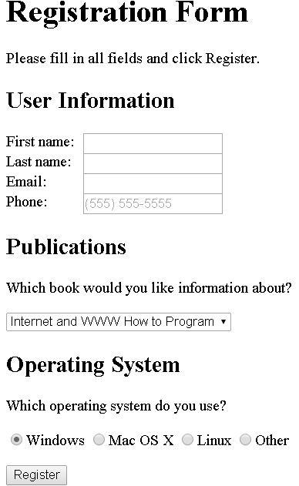
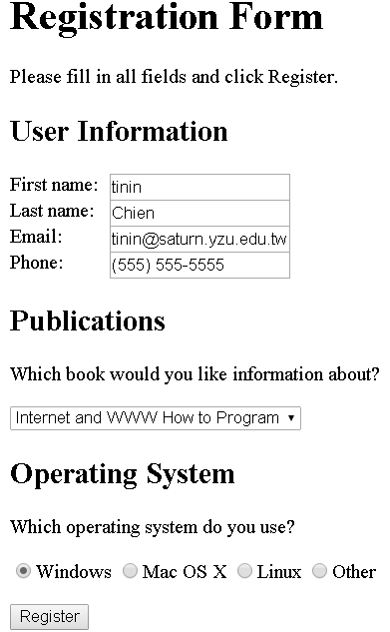
Form Processing and Business Logic

Slide 29
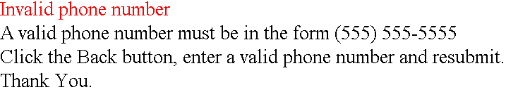
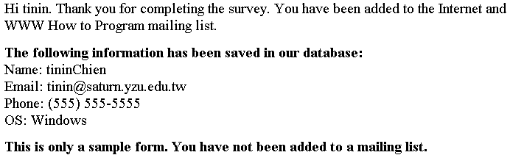
Form Processing and Business Logic
<!DOCTYPE html>
<html>
<head>
<meta charset = "utf-8">
<title>Form Validation</title>
<style type = "text/css">
p { margin: 0px; }
.error { color: red }
p.head { font-weight: bold; margin-top: 10px; }
</style>
</head>
<body>
<?php
if (!preg_match( "/^\([0-9]{3}\) [0-9]{3}-[0-9]{4}$/", $_POST["phone"]))
{
print( "<p class = 'error'>Invalid phone number</p>
<p>A valid phone number must be in the form
(555) 555-5555</p><p>Click the Back button,
enter a valid phone number and resubmit.</p>
<p>Thank You.</p></body></html>" );
die(); // terminate script execution
}
?>
<p>Hi <?php print( $_POST["fname"] ); ?>. Thank you for
completing the survey. You have been added to the
<?php print( $_POST["book"] ); ?> mailing list.</p>
<p class = "head">The following information has been saved
in our database:</p>
<p>Name: <?php print( $_POST["fname"] );
print( $_POST["lname"] ); ?></p>
<p>Email: <?php print( $_POST["email"] ); ?></p>
<p>Phone: <?php print( $_POST["phone"] ); ?></p>
<p>OS: <?php print( $_POST["os"] ); ?></p>
<p class = "head">This is only a sample form.
You have not been added to a mailing list.</p>
</body>
</html>
Form.php

Slide 30
<form method = "post" action = "form.php">
<h2>User Information</h2>
<div><label>First name:</label><input type = "text" name = "fname"></div>
<div><label>Last name:</label><input type = "text" name = "lname"></div>
<div><label>Email:</label><input type = "text" name = "email"></div>
<div><label>Phone:</label><input type = "text" name = "phone"
placeholder = "(555) 555-5555"></div>
<h2>Publications</h2>
<p>Which book would you like information about?</p>
<select name = "book">
<option>Internet and WWW How to Program</option>
<option>C++ How to Program</option>
<option>Java How to Program</option>
<option>Visual Basic How to Program</option>
</select>
<h2>Operating System</h2>
<p>Which operating system do you use?</p>
<p><input type = "radio" name = "os" value = "Windows" checked>Windows
<input type = "radio" name = "os" value = "Mac OS X">Mac OS X
<input type = "radio" name = "os" value = "Linux">Linux
<input type = "radio" name = "os" value = "Other">Other</p>
<p><input type = "submit" name = "submit" value = "Register"></p>
</form>
<p>Hi <?php print( $_POST["fname"] ); ?>. Thank you for
completing the survey. You have been added to the
<?php print( $_POST["book"] ); ?> mailing list.</p>
<p class = "head">The following information has been saved
in our database:</p>
<p>Name: <?php print( $_POST["fname"] );
print( $_POST["lname"] ); ?></p>
<p>Email: <?php print( $_POST["email"] ); ?></p>
<p>Phone: <?php print( $_POST["phone"] ); ?></p>
<p>OS: <?php print( $_POST["os"] ); ?></p>
<p class = "head">This is only a sample form.
You have not been added to a mailing list.</p>

Slide 31
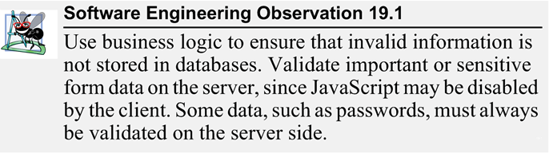
Form Processing and Business Logic

Slide 32
Exercise
method = "post" -> method = "get“
$_POST -> $_GET

Slide 33
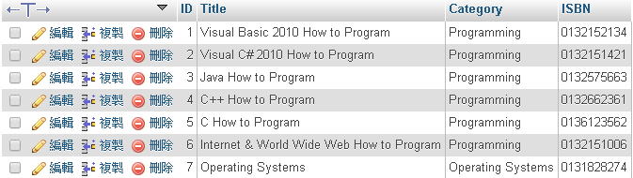
Reading from a Database
Upload product.sql to Mysql Server

Slide 34
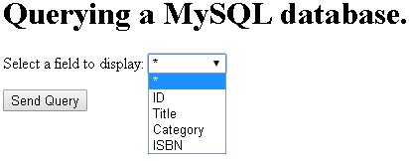
Reading from a Database
<!DOCTYPE html>
<html>
<head>
<meta charset = "utf-8">
<title>Sample Database Query</title>
</head>
<body>
<h1>Querying a MySQL database.</h1>
<form method = "post" action = "database.php">
<p>Select a field to display:
<select name = "select">
<option selected>*</option>
<option>ID</option>
<option>Title</option>
<option>Category</option>
<option>ISBN</option>
</select></p>
<p><input type = "submit" value = "Send Query"></p>
</form>
</body>
</html>

Slide 35
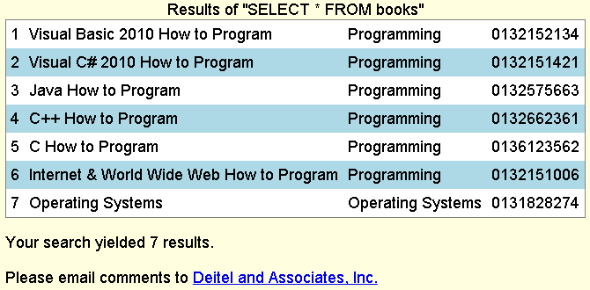
<!DOCTYPE html>
<html>
<head><meta charset = "utf-8"><title>Search Results</title>
<style type = "text/css">
body { font-family: sans-serif;
background-color: lightyellow; }
table { background-color: lightblue;
border-collapse: collapse;
border: 1px solid gray; }
td { padding: 5px; }
tr:nth-child(odd) { background-color: white; }
</style>
</head>
<body>
<?php
$select = $_POST["select"];
$query = "SELECT " . $select . " FROM books";
if ( !( $database = mysql_connect( "localhost", "USERID", "password" ) ) )
die( "Could not connect to database </body></html>" );
if ( !mysql_select_db( "products", $database ) )
die( "Could not open products database </body></html>" );
if ( !( $result = mysql_query( $query, $database ) ) )
{
print( "<p>Could not execute query!</p>" );
die( mysql_error() . "</body></html>" );
}
mysql_close( $database );
?>
<table>
<caption>Results of "SELECT <?php print( "$select" ) ?> FROM books"</caption>
<?php
while ( $row = mysql_fetch_row( $result ) )
{
print( "<tr>" );
foreach ( $row as $value )
print( "<td>$value</td>" );
print( "</tr>" );
}
?>
</table>
<p>Your search yielded <?php print( mysql_num_rows( $result ) ) ?> results.</p>
<p>Please email comments to <a href = "mailto:deitel@deitel.com"> Deitel and Associates, Inc.</a></p>
</body>
</html>

Slide 36
Reading from a Database
if ( !( $database = mysql_connect( "localhost", "USERID", "password" ) ) )
die( "Could not connect to database </body></html>" );
if ( !mysql_select_db( "products", $database ) )
die( "Could not open products database </body></html>" );
if ( !( $result = mysql_query( $query, $database ) ) )
{
print( "<p>Could not execute query!</p>" );
die( mysql_error() . "</body></html>" );
}
mysql_close( $database );
while ( $row = mysql_fetch_row( $result ) )
{
print( "<tr>" );
foreach ( $row as $value )
print( "<td>$value</td>" );
print( "</tr>" );
}
print( mysql_num_rows( $result ) )
resource mysql_connect (string $servername , string $username, string $password)
Open a connection to a MySQL Server
bool mysql_select_db ( string $database_name , resource $link_identifier)
Select a MySQL database
mixed mysql_query ( string $query , resource $link_identifier)
Send a MySQL query
string mysql_error()
Returns the text of the error message from previous MySQL operation
bool mysql_close (resource $link_identifier )
Close MySQL connection
array mysql_fetch_row ( resource $result )
Get a result row as an enumerated array // $row[0] , $row[1]…
int mysql_num_rows ( resource $result )
Get number of rows in result

Slide 37
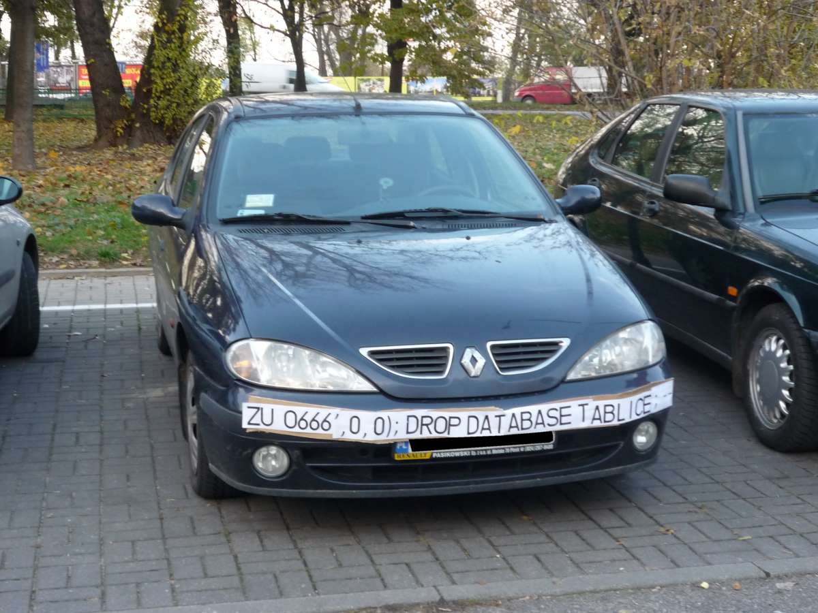
sql injection
A SQL injection attack consists of insertion or "injection" of a SQL query via the input data from the client to the application

Slide 38
PHP7 connect to MySQL
PHP5
function name: mysql_xxxx
mysql_connect()
mysql_query()
mysql_query( $query, $database )
PHP7
function name: mysqli_xxxx
mysqli_connect()
mysqli_query()
mysqli_query( $database ,$query)

Slide 39
PHP7 connect to MySQL
PHP7
<?php
$select = $_POST["select"];
$query = "SELECT " . $select . " FROM books";
if ( !( $database = mysqli_connect( "localhost", "USERID", "password" ) ) )
die( "Could not connect to database </body></html>" );
if ( !mysqli_select_db($database,"products" ) )
die( "Could not open products database </body></html>" );
if ( !( $result = mysqli_query($database, $query) ) )
{
print( "<p>Could not execute query!</p>" );
die( mysqli_error() . "</body></html>" );
}
mysqli_close( $database );
print ("<table>");
while ( $row = mysqli_fetch_row( $result ) )
{
print( "<tr>" );
foreach ( $row as $value )
print( "<td>$value</td>" );
print( "</tr>" );
}
print ("</table>");
?>

Slide 40
<!DOCTYPE html>
<html>
<head><meta charset = "utf-8"><title>Search Results</title>
<style type = "text/css">
body { font-family: sans-serif;
background-color: lightyellow; }
table { background-color: lightblue;
border-collapse: collapse;
border: 1px solid gray; }
td { padding: 5px; }
tr:nth-child(odd) { background-color: white; }
</style>
</head>
<body>
<?php
$select = $_POST["select"];
$query = "SELECT " . $select . " FROM books";
if ( !( $database = mysqli_connect( "localhost", "USERID", "password" ) ) )
die( "Could not connect to database </body></html>" );
if ( !mysqli_select_db($database", products" ) )
die( "Could not open products database </body></html>" );
if ( !( $result = mysqli_query($database, $query) ) )
{
print( "<p>Could not execute query!</p>" );
die( mysqli_error() . "</body></html>" );
}
mysqli_close( $database );
?>
<table>
<caption>Results of "SELECT <?php print( "$select" ) ?> FROM books"</caption>
<?php
while ( $row = mysqli_fetch_row( $result ) )
{
print( "<tr>" );
foreach ( $row as $value )
print( "<td>$value</td>" );
print( "</tr>" );
}
?>
</table>
<p>Your search yielded <?php print( mysqli_num_rows( $result ) ) ?> results.</p>
<p>Please email comments to <a href = "mailto:deitel@deitel.com"> Deitel and Associates, Inc.</a></p>
</body>
</html>

Slide 41
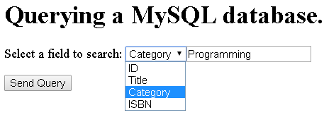
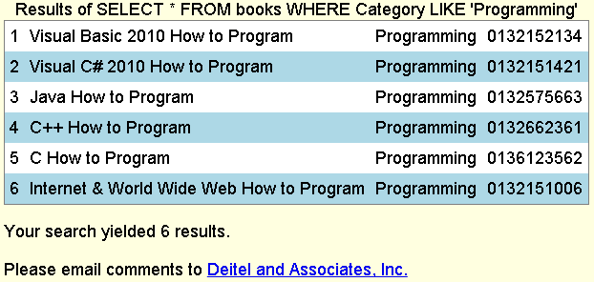
Exercise

Slide 42
Using Cookies
A cookie is a piece of information that’s stored by a server in a text file on a client’s computer to maintain information about the client during and between browsing sessions.
A server can access only the cookies that it has placed on the client.
A cookies has an expiration date, after which the web browser deletes it.

Slide 43
Using Cookies
<!DOCTYPE html>
<html>
<head>
<meta charset = "utf-8">
<title>Writing a cookie to the client computer</title>
<style type = "text/css">
label { width: 7em; float: left; }
</style>
</head>
<body>
<h2>Click Write Cookie to save your cookie data.</h2>
<form method = "post" action = "cookies.php">
<div><label>Name:</label>
<input type = "text" name = "name"><div>
<div><label>Height:</label>
<input type = "text" name = "height"></div>
<div><label>Favorite Color:</label>
<input type = "text" name = "color"></div>
<p><input type = "submit" value = "Write Cookie">
</form>
</body>
</html>

Slide 44
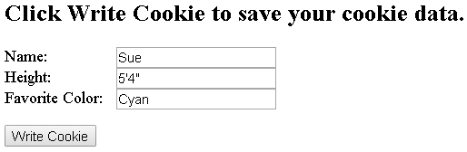
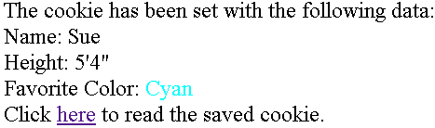
Using Cookies
cookies.php
<?php
define( "FIVE_DAYS", 60 * 60 * 24 * 5 ); // define constant
setcookie( "name", $_POST["name"], time() + FIVE_DAYS );
setcookie( "height", $_POST["height"], time() + FIVE_DAYS );
setcookie( "color", $_POST["color"], time() + FIVE_DAYS );
?>
<!DOCTYPE html>
<html>
<head>
<meta charset = "utf-8">
<title>Cookie Saved</title>
<style type = "text/css">
p { margin: 0px; }
</style>
</head>
<body>
<p>The cookie has been set with the following data:</p>
<p>Name: <?php print( $_POST["name"] ) ?></p>
<p>Height: <?php print( $_POST["height"] ) ?></p>
<p>Favorite Color:
<span style = 'color:<?php print( $_POST["color"]) ?> '>
<?php print( $_POST["color"] ) ?></span></p>
<p>Click <a href = "readCookies.php">here</a>
to read the saved cookie.</p>
</body>
</html>
bool setcookie ( string $name , string $value , int $expire)
Send a cookie

Slide 45
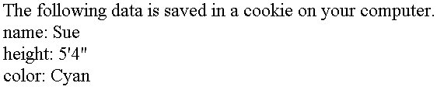
Using Cookies
<!DOCTYPE html>
<html>
<head>
<meta charset = "utf-8">
<title>Read Cookies</title>
<style type = "text/css">
p { margin: 0px; }
</style>
</head>
<body>
<p>The following data is saved in a cookie on your computer.</p>
<?php
foreach ($_COOKIE as $key => $value )
print( "<p>$key: $value</p>" );
?>
</body>
</html>
$_COOKIE["name"]
$_COOKIE["height"]
$_COOKIE["color"]

Slide 46
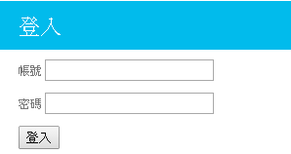
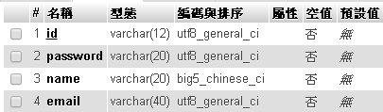


Exercise
User Login

Slide 47
Q&A

